Slide 1

Successor representation: a model of temporal context and semantics
Laura Convertino
Jesse Geerts

Slide 2
Original Task – Pu et al. 2022
Experiment 2 – short lists
Experiment 3 - serial positions
Experiment 4 - lags

Slide 3
Experiment 1 – semantic context
Cat
Dog
Shark
Cow
Owl
Rose
Daisy
Violet
Chair
Tree
Mirror
Police
Book
Hat
Bag
Street
What word was presented later?
Rose
Cat
Others?
Lists length
lags

Slide 4
Experiment 2 – semantic and temporal context
Cat
Dog
Shark
Cow
Owl
Rose
Daisy
Violet
Cat
Dog
Shark
Cow
Owl
Rose
Daisy
Violet
Chair
Tree
Mirror
Police
Book
Hat
Bag
Street

Slide 5
Experiment 3 – semantic and temporal distance + background context
Globe
Village
Town
Region
Globe
Nation
Hut
City
Minute
Century
Hour
Second
Day
Year
Era
Month
Letter
Book
Word
Sentence
Encyclopedia
Paragraph
Chapter

Slide 6
Experiment 4 – Words Repetitions
Cat
Dog
Shark
Cat
Dog
Rose
Daisy
Violet
Chair
Tree
Mirror
Police
Book
Hat
Tree
Mirror
Experiment 5 – Category Repetition
Rose
Cat
Dog
Shark
Daisy
Violet
Cow
Owl

Slide 7
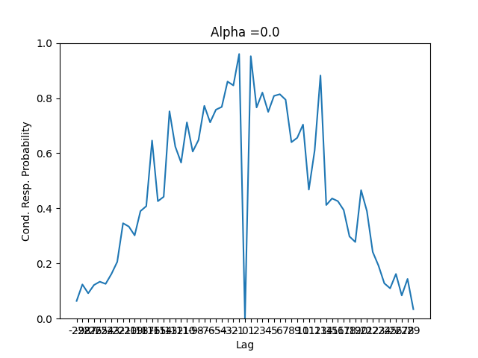
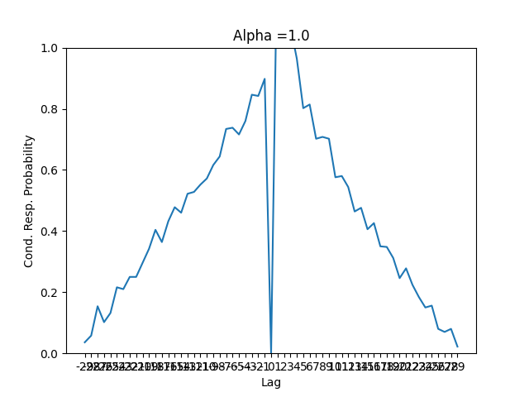
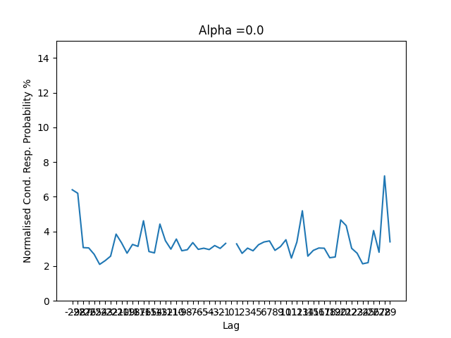
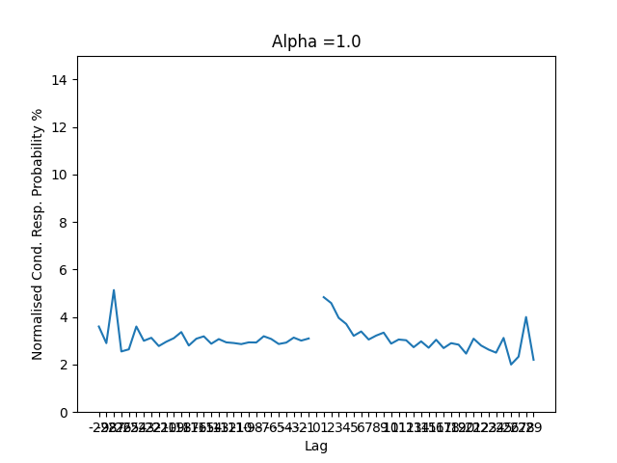
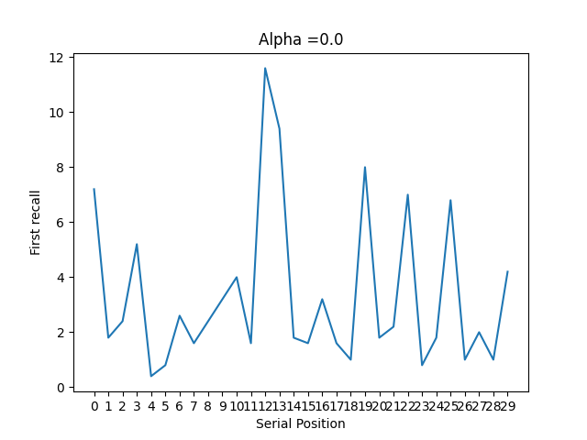
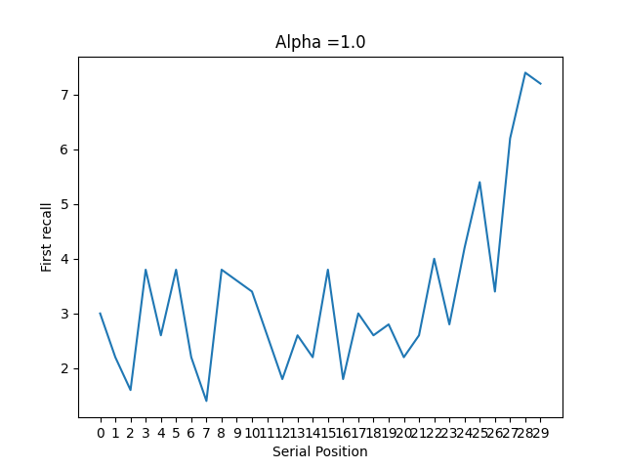
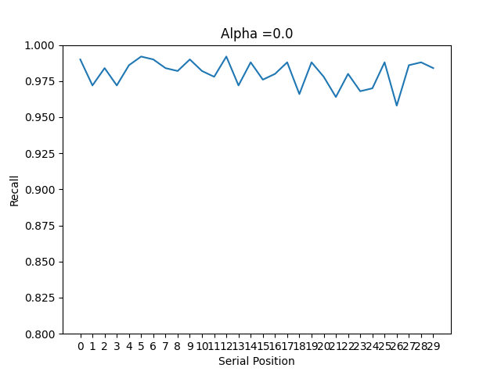
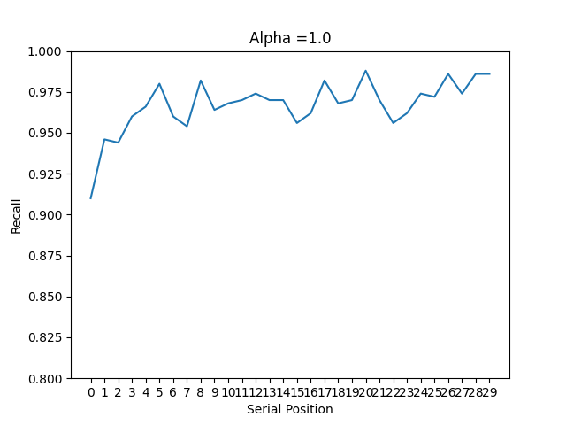
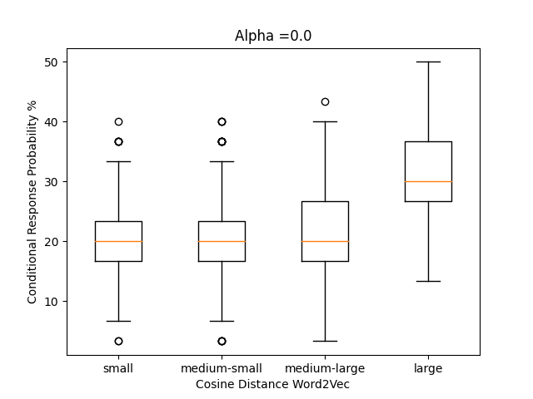
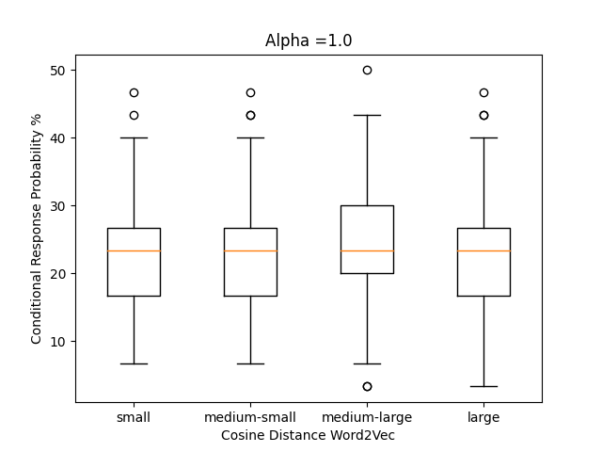
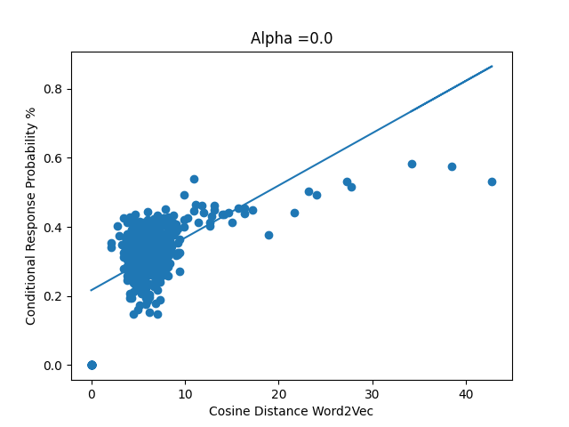
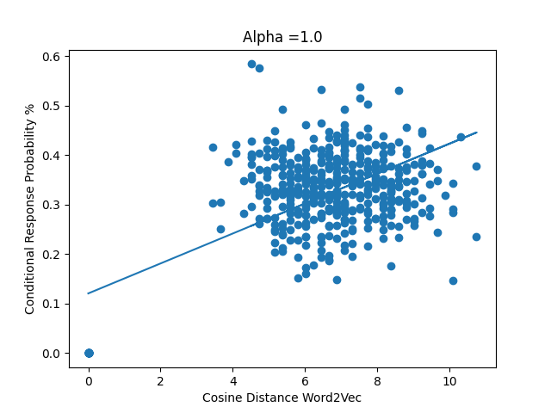
Model Results – list free recall, no repetitions

